Slide 1

Introduction to HTML/CSS
Kunal Kashyap
Arushi Shukla

Slide 2
An Introduction to
HTML

Slide 3
Agenda
What is HTML ?
Document Structure
Meta tags
HTML elements
Basic HTML tags
HTML form elements
HTML Tables
Classes and Ids
W3c validations

Slide 4
What is HTML?
1. HTML abbreviated for Hyper Text Markup Language
2. A markup language is a set of markup tags
3. Each HTML tag describes different document content
4. HTML tags normally come in pairs like <p> and </p>

Slide 5
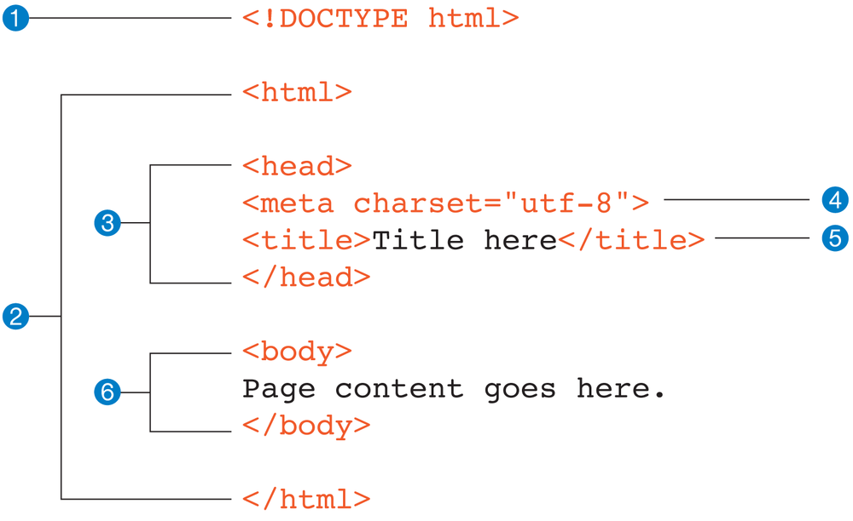
Document Structure

Slide 6
Meta tags
The <meta> tag provides metadata about the HTML document. Metadata will not be displayed on the page, but will be machine parsable.
Meta elements are typically used to specify page description, keywords, author of the document, last modified, and other metadata. Also, it helps to improve the SEO( Search Engine Optimization) of a web page by using certain keywords related to the web page.
<meta> tags always go inside the <head> element.
Following are few examples of <meta> tag with different attributes :
<meta name="keywords" content="HTML, CSS, XML, XHTML, JavaScript"> (For Search engines)
<meta name="description" content="Free Web tutorials on HTML and CSS"> ( Description of web page)
<meta name="author" content="John Doe"> (Author of web page)
<meta name="viewport" content="width=device-width, initial-scale=1.0"> (Responsiveness)

Slide 7
How it looks in browser?
Demo

Slide 8
Elements inside BODY element
HTML elements are written with a start tag, with an end tag, with the content in between:
Syntax :: <tagname>element content</tagname>
<p>MY First Paragraph.</p>
<div>My Container</div>
<h1>Heading1</h1>
The elements which has not the end tag are called self-closing tags , as - <br />, <hr/>, <img />,<input />

Slide 9
Basic HTML tags
Headings tags
Paragraph tag
Hyperlink tag
Order list and Unordered list tags
Miscellaneous tag

Slide 10
HTML Headings
Headings are defined with the <h1> to <h6> tags.
<h1> defines the most important heading. <h6> defines the least important heading.
Samples of the six heading types:
<H1>Level-1 (H1)</H1>
<H2 >Level-2 (H2)</H2>
<H3>Level-3 (H3)</H3>
<H4 >Level-4 (H4)</H4>
<H5>Level-5 (H5)</H5>
<H6>Level-6 (H6)</H6>

Slide 11
HTML Paragraphs
The HTML <p> element defines a paragraph.
Example:
<p>This is a paragraph</p>
<p>This is another paragraph</p>

Slide 12
HTML Links - Hyperlinks
HTML links are hyperlinks.
A hyperlink is a text or an image you can click on, and jump to another document.
Example:
<a href="url">link text</a>
<a href=" url ">
<img src="smiley.gif" alt="HTML tutorial" style="width:42px;height:42px;border:0">
</a>

Slide 13
HTML Lists
Example of an unordered list and an ordered list in HTML:
Unordered List:
<ul>
<li> First item </li>
<li> Second item </li>
<li> Third item </li>
</ul>
Ordered List:
<ol>
<li> First item </li> 1. First item
<li> Second item </li> 2. Second item
<li> Third item </li> 3. Third item
</ol>
First Item
Second Item
Third Item

Slide 14
Miscellaneous
STRONG – The HTML Strong Element (<strong>) gives text strong importance, and is typically displayed in bold.
HR - The <hr> element is used to separate content in an HTML page.
BR - The <br> tag inserts a single line break.
DIV -The <div> tag defines a division or a section in an HTML document and is used to group block-elements to format them with CSS.
SPAN - The <span> tag is used to group inline-elements in a document.

Slide 15
Block-level and Inline-level Elements
There are two types of elements in HTML page – INLINE and BLOCK.
A block-level element always starts on a new line and takes up the full width available (stretches out to the left and right as far as it can).
The <div> element is a block-level element.
An inline element does not start on a new line and only takes up as much width as necessary.
This <span> element is an inline-level element.
Demo

Slide 16
HTML Form Elements
The most important form element is the <input> element.
Type of an input element decided by its “type” attribute
Some basic input types :
- text input - <input type=“text” />
- password input - <input type=“password” />
- email input - <input type=“email” />
- checkbox input - <input type=“checkbox” />
- radio input - <input type=“radio” />
- submit button - <input type=“submit” />

Slide 17
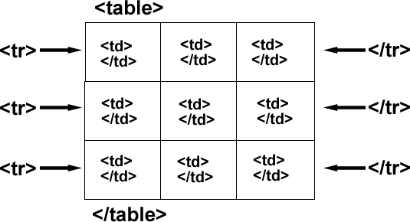
HTML Tables
Tables are defined with the <table> tag.
Tables are divided into table rows with the <tr> tag.
Table rows are divided into table data with the <td> tag.
A table row can also be divided into table headings with the <th> tag.

Slide 18
Example of Table
<table style="width:100%">
<thead>
<tr>
<th>Lastname</th>
<th>Points</th>
</tr>
</thead>
<tbody>
<tr>
<td>Smith</td>
<td>50</td>
</tr>
<tr>
<td>Jackson</td>
<td>94</td>
</tr>
</tbody>
<tfoot>
<tr>
<td>Copyright</td>
<td> @ TTN </td>
</tr>
</tfoot>
</table>

Slide 19
Classes and Ids
You should only give elements an ID attribute if they are unique. They should be applied to that element only and nothing else.
Classes can be applied to multiple elements that share the same style properties. Things that should look and work in the same way can have the same class name.
Example: <ul id="categories">
<li class="item">Category 1</li>
<li class="item">Category 2</li>
<li class="item">Category 3</li>
</ul>

Slide 20
Introduction to HTML5

Slide 21
Agenda
Semantic Tags
API’S
HTML5 Form Validations

Slide 22
HTML5 Tags
HTML5 is the latest version of HTML and it introduces many new <tags> and features.
Some of the commonly used new tags of HTML5 are :
<article> - Defines an article in the document
<aside> - Defines content aside from the page content like sidebar.
<footer> - Defines a footer for the document or a section
<header> - Defines a header for the document or a section
<nav> - Defines navigation links in the document
<section> - Defines a section in the document

Slide 23
HTML5 APIs
Web Audio API -- It provides a simple yet powerful mechanism to implement and manipulate audio content inside web applications. It allows you to develop complex audio mixing, effects, panning and more.
Geolocation API -- It allows the user to provide their location to web applications if they so desire. For privacy reasons, the user is asked for permission to report location information.
Web Storage API -- It provides mechanisms by which browsers can store key/value pairs, in a much more intuitive fashion than using cookies.
Page Visibility API -- performs a simple but important function – it lets your application know when a page is visible to the user.
Vibration API -- allows developers to direct the device, using JavaScript, to vibrate in a pattern for a given duration if the device has the vibration mechanism.
There are many more HTML5 APIs. Above were the ones which are being mostly used these.

Slide 24

HTML5 Form Validations
We use Html5 form validations for verifying the form data on the client side itself. In Html5 new input types and attributes were added to <input> tags that allow the browsers themselves to perform the client-side validation for us: no JavaScript required.
Lets have a better understanding with the help of following example :
<form>
<input type=“text” id="name" required>
<input type=“submit” value=“Submit”/>
</form>
Validating required fields is as easy as adding the required attribute to each <input> tag.
Now, If one tries to submit the form without filling anything in input field. A tooltip will appear on that particular field which is not validating according to the requirement.

Slide 25
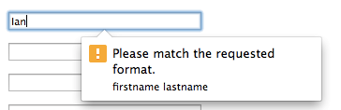
HTML5 Form Validations
We can also tell the browser that which type of data we want in a particular field by applying regular expressions in an <input> tag attribute known as pattern.
For example :
<input id="name“ type=“text” name="name" required pattern="[A-Za-z]" title="firstname lastname">
Now if a user tries to submit the form without filling the required data, a tooltip will appear reminding that it is not a valid input.

Slide 26
An Introduction to
CSS

Slide 27
Agenda
What is CSS?
Type of CSS
Selectors
Id and Class
Box Model
CSS Properties

Slide 28
What is CSS?
CSS stands for Cascading Style Sheets
CSS is used to define styles for your web pages, including the design, layout and variations in display for different devices and screen sizes.
control layout of many documents from one single style sheet;

Slide 29
Type of CSS
There are three types of CSS
1. Inline CSS
2. Internal CSS
3. External Style CSS

Slide 30
Inline Style
<p style="color: #ff0000;">Some red text</p>
Internal Style
<head>
<title><title>
<style type="text/css">
.alternate{background:#ff0000;}
#alternate{background:#ff0000;}
</style>
</head>
External Style Sheet
<head>
<title><title>
<link rel="stylesheet" type="text/css" href="style.css" />
</head>

Slide 31
Selectors
In CSS, selectors are patterns used to select the element(s)
You want to style.
selector { property: value }
body {background: #eeeeee; font-family: Georgia, sans-serif;}
h1 {font-family: Georgia, sans-serif;}
h1, h2 {color: #009900;font-family: Georgia, sans-serif;}

Slide 32
Id and Class
ID's are unique
Each element can have only one ID
Each page can have only one element with that ID
Classes are NOT unique
You can use the same class on multiple elements.
You can use multiple classes on the same element.
Syntax:
#id {property: value}
.class {property: value}

Slide 33
Padding and Margin
padding-top:10px;
padding-right:10px;
padding-bottom:10px;
padding-left:10px;
Or
padding:10px;
margin-top:10px;
margin-right:10px;
margin-bottom:10px;
margin-left:10px;
Or
margin:10px;
In-Short: padding /margin: top-gap px , right-gap px ,bottom-gap px ,left-gap px

Slide 34
Box Model
.
CONTENT
margin
padding
border

Slide 35
Display Property
display is CSS's most important property for controlling
layout. Every element has a default display value depending
on what type of element it is.
display: block;
display: inline;
display: inline-block;
display: none;

Slide 36
Color
Colors are displayed combining RED, GREEN, and BLUE light.
color: value;
#container {
Width: 70px;
Height:200px;
padding: 30px;
border: 1px solid #666;
color: #ffffff; }

Slide 37
Text Align
The text-align CSS property describes how inline content
like text is aligned in its parent block element. text-align does
not control the alignment of block elements, only their
inline content.
Syntax:
text-align: value;
text-align: left;
text-align: right;
text-align: center;
text-align: justify;

Slide 38
Clear and float
Clear:both;
Clear:left;
Clear:right;
Float:left;
Float:right;

Slide 39
Text Decoration
text-decoration: none
text-decoration: underline
Font -Family, Font Size
font-family: Verdana, sans-serif;
font-size: 15px;
Font Weight
font-weight: Value
font-weight: bold;
font-weight: normal;
font-weight: numbers; (300, 400, 600, 800)

Slide 40
Link
<a href="" title="">some link text</a>
a {color: #009900;}
Pseudo classes
a:visited {color: #999999;}
a:hover {color: #333333;}
a:focus {color: #333333;}
a:active {color: #009900;}

Slide 41
Background and border
background: #ffffff;
background: url(path of image);
background: #ffffff url(path of image)
border: 1px solid #333333;
border-top: 1px solid #333333;
border-right: 1px solid #333333;
border-bottom: 1px solid #333333;
border-left: 1px solid #333333;

Slide 42
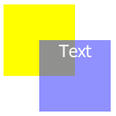
Position and z-index
position: absolute;
position: relative;
position: fixed;
position: static;
z-index: 1;
.yellow-box{position: relative; z-index: 1;}
.blue-box{position: relative; z-index: 2;}

Slide 43
Introduction to CSS3

Slide 44
Agenda
Animation
Transation
Media Queries
Flexbox

Slide 45
CSS3 Animations
What are CSS3 Animations?
An animation lets an element gradually change from one style to another. You can change as many CSS properties you want, as many times you want. To use CSS3 animation, you must first specify some keyframes for the animation.
Keyframes hold what styles the element will have at certain times.
@keyframes example { 0% {background-color: red;}
50% {background-color: green;}
100% {background-color: yellow;} }
div { width: 100px; height: 100px; background-color: red; animation-name: example; animation-duration: 4s; }

Slide 46
CSS3 Transitions
CSS3 transitions allows you to change property values smoothly.
For example :
div {
width: 100px;
height: 100px;
background: red;
transition: width 2s;
}
div:hover {
width: 300px;
}

Slide 47
CSS3 media queries
When we have to make a web page responsive, we need to specify that which CSS properties will be applied on a particular viewport (device screen). This can be achieved by using media queries in our CSS file.
Let’s understand this better with an example
@media screen and (min-width: 480px) { body { background-color: lightgreen; } }
So, the above code will work only when the device width is at least 480px. Hence, this code will not work on devices who’s width will be less than 480px.

Slide 48
CSS3 Flexbox
Flexbox is Flexible Box Layout Module
It is mainly a flexible container inshort flexbox
CSS floats and clearfix hacks are very much popular to get proper
multi-column layouts.
Flexbox is an alternative for this.
In future it can overcome Floats and clearfixs.
It’s great for mobile screens and responsive content for dynamic layouts and
webapps.

Slide 49
Exercises

Slide 50
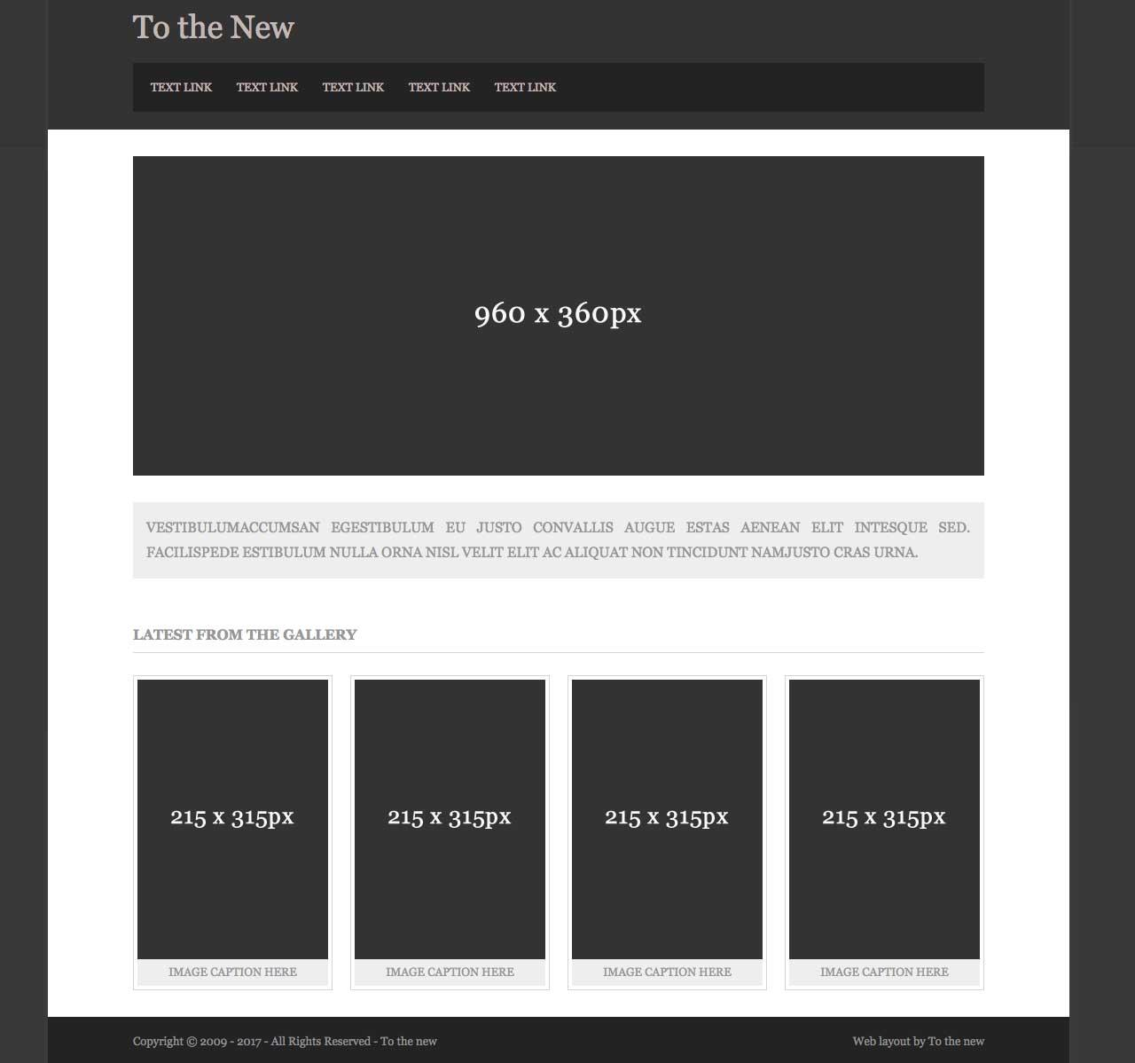
1. Please create the following web page using html5 tags and required css.

Slide 51
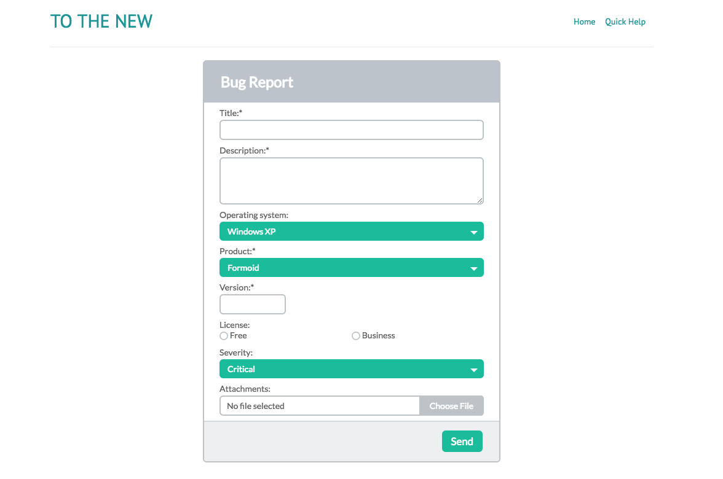
2. Please create the following form using required html5 form tags.

Slide 52
Thank You

